Slide 1
r/place Analysis
Eva Murdock, Alexa Hildebrand, Fernando Fonseca

Slide 2
Our Goal
Analyze the full time activity data from r/place 2023 to understand the impact of bots on the artwork

Slide 3

The Motivation
“It’s literally a competition to see who knows how to bot better. Every single name I’ve looked at has 1 karma and no posts or comments. And I looked at 40-50 of them before I gave up.”
“I have seen so many art pieces and community artworks destroyed because of bots and streamers. I think reddit needs to come up with a solution to this for next year because it's getting ridiculous…”
“A coworker and I considered drawing a small figure in an obscure area but by the time we could lay a different pixel our first had changed a few times. Oh well.”

Slide 4
Our Method
01
Groupby Fxn
02
Multiprocessing
03
Partition
04
Join
Create a function that uses groupby to compress data into important stats
Put the function into a script that utilizes multiprocessing
Run the multiprocessing script 5 times with 1/5 of the data each
Join together the csvs that were created from each of the 5 runs
Notes:
Pool from multiprocessing library
Joined then grouped by user

Slide 5
Summary Statistics

Slide 6
15.2
Average pixels placed by user
31.71
Average minutes between pixels
7504
Maximum pixels placed by a user*
2
Median amount of unique colors used
8520740
Number of unique users

Slide 7
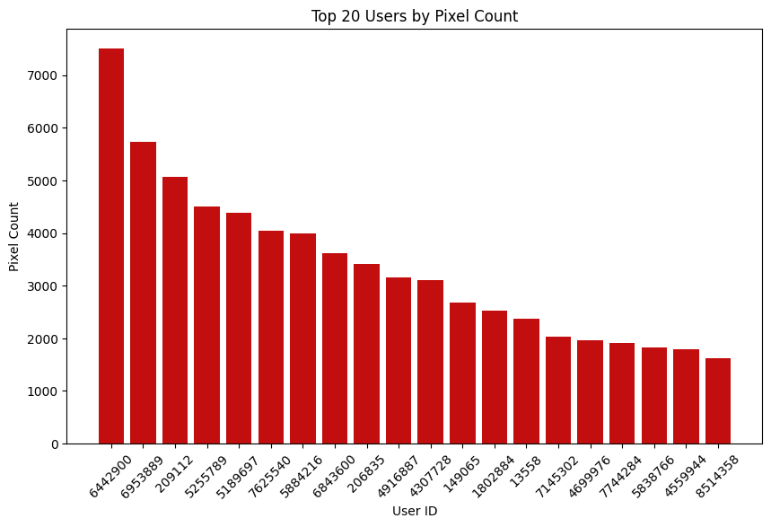
Admin Privileges Theory
Placing every 5 minutes, this would take 26 days

Slide 8
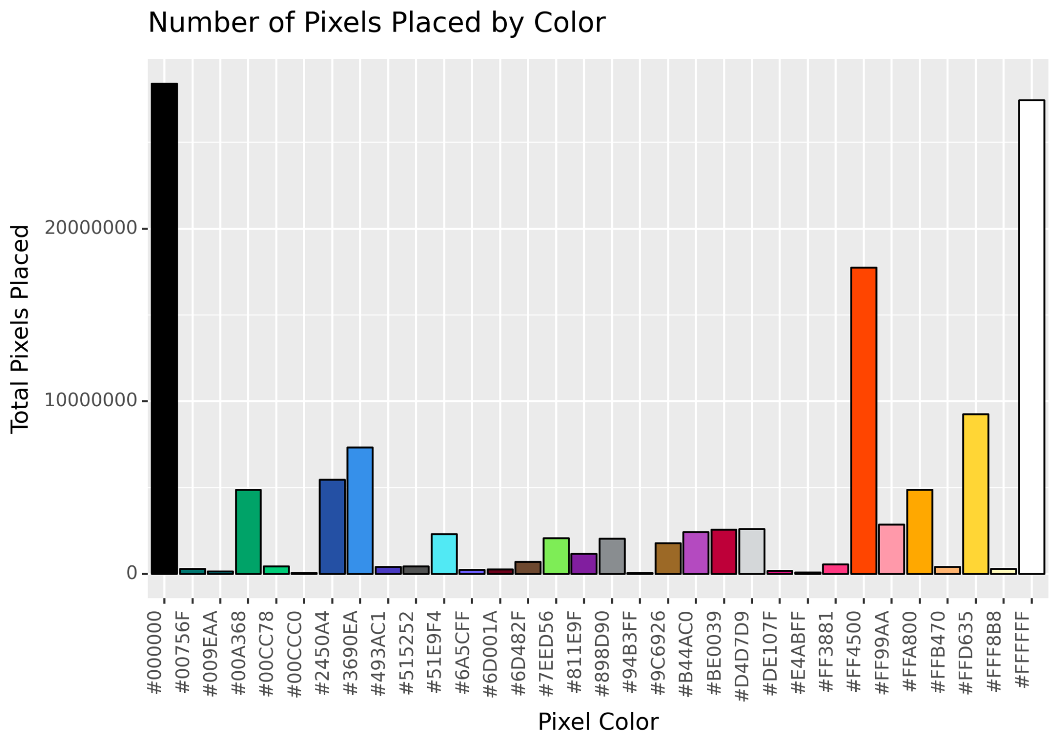
Notes:
Black, white, redish/orange

Slide 9
Bot Hypothesis
Investigate time between pixel placement for each user and areas with highest number of changes
Notes:
https://economictimes.indiatimes.com/news/international/us/reddit-launches-2023-edition-of-r/place-what-is-it-and-why-are-redditors-posting-against-steve-huffman-heres-all-you-need-to-know/articleshow/101995639.cms?from=mdr

Slide 10
Avg Time Difference Between Changes is exactly 5 or 20 minutes
Reasoning: A verified user could place a pixel every 5 minutes, an unverified user can place a pixel every 20 minutes. Exact average time difference as a whole number is also suspicious.
Notes:
For example, there were a lot of exactly 6 min average time difference between pixel placed

Slide 11
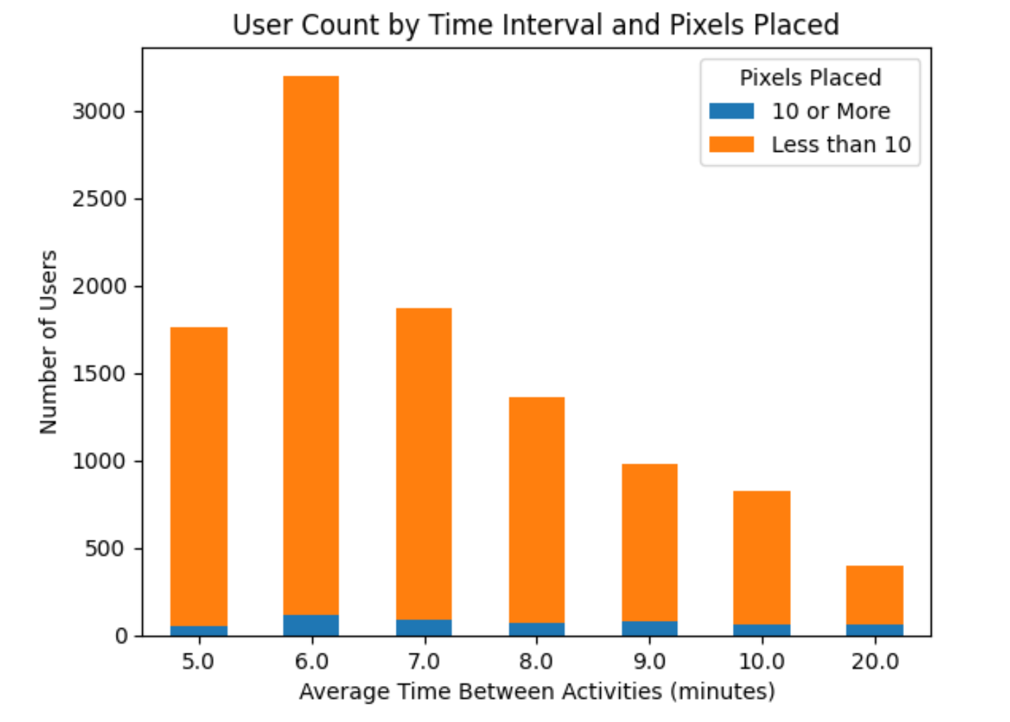

Slide 12
Most Changed Coordinates
Reasoning: Reddit pages claimed people had bot armies that would protect/attack certain art. This could mean that most changed coordinates represent bot attacks.

Slide 13

Most Changed Coordinate: (0,0)
Center

Slide 14

#2 Most Changed Coordinate (-1500,-1000)
Top Corner

Slide 15
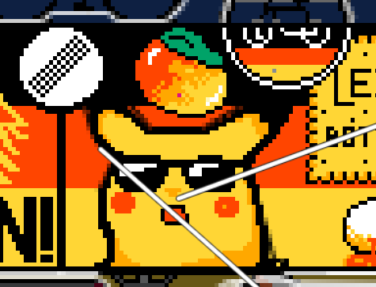
Surprised Pikachu - part of German Flag
#3 Most Changed Coordinate (20,-401)

Slide 16

Vietnamese Poster
#4 Most Changed Coordinate (99,499)

Slide 17
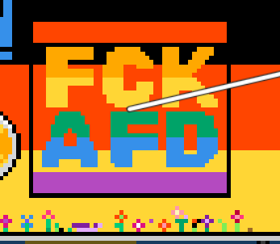
German Political Statement, German Flag
#5 and #6 Most Changed Coordinate
(-251, -415) and (-251, -416)

Slide 18
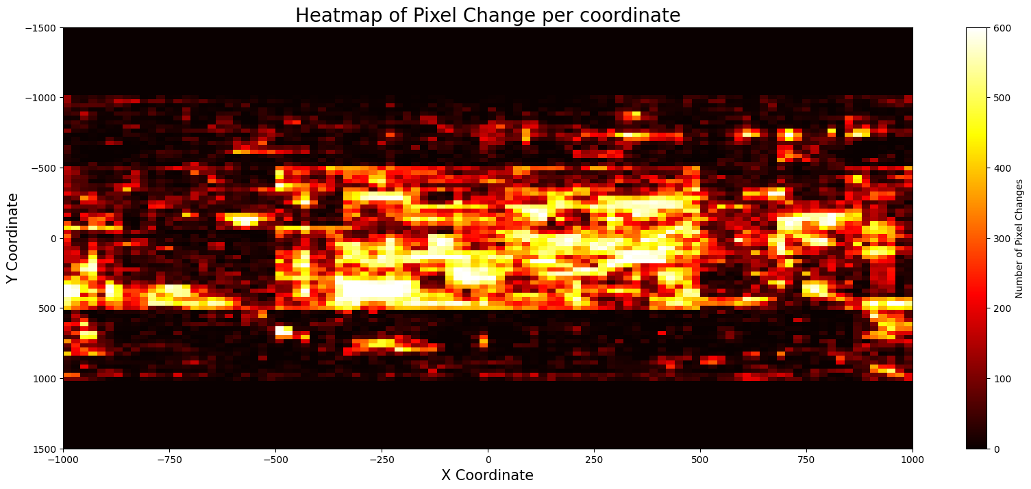
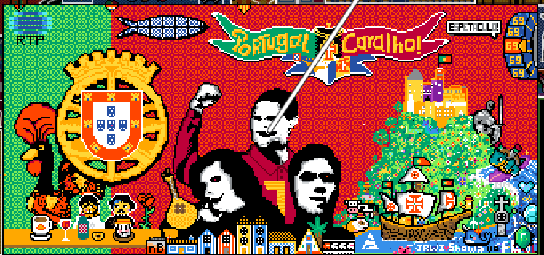
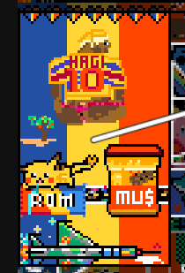
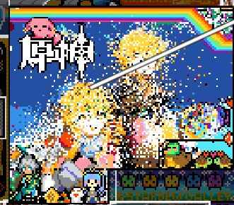

Flag of Romania: Many reddit users believe believe most country flags were made by bots
Genshin Impact: A Chinese video game, notoriously raided over 50 times
Flag of Turkey: Many reddit users believe Turkish bots worked on this flag
Flag of Portugal: The Portuguese Reddit community famously had major conflicts and had multiple failed votes on the design, losing allies and being attacked many times
Notes:
https://www.reddit.com/r/place/comments/1555uzm/turkey_is_only_made_of_bots/
https://www.reddit.com/r/place/comments/155pbvs/country_flag_bots_ruin_the_actual_fun_aspect_of/

Slide 19
Questions?

